Slide 1


St. Clair College
Smart Campus
Energy Management System
Group - 001
Kayode Babalola
Qianru Deng
Priyanka Sharma
1

Slide 2








St. Clair College
01
Project Overview
05
Methodology
02
Project Scope
06
Solution Roadmap
03
Risks, Limitations and Assumptions
07
Project Plan
04
Financial Summary
08
Implementation
09
Conclusion & Deleverables
Agenda
2

Slide 3

St. Clair College
Project Overview
01
Project Background
The project aims to develop a Smart Campus Energy Management System for energy auditing, real-time monitoring via sensors and dashboards, and campus-wide sustainability education.
02
Problem or Issues
Higher education campuses typically face high energy consumption with limited real-time monitoring and engagement to encourage sustainable practices among students and staff.
03
Project Goals
Audit campus energy, deploy sensors and dashboards, engage the community, and achieve a 10% reduction in consumption within one year while tracking usage monthly.
3

Slide 4



St. Clair College
Project Scope
Within Scope
  Audit energy use across all campus buildings
  Install sensors and create real-time dashboards
  Run educational campaigns for students, faculty, and staff
  Analyze data and produce actionable sustainability reports
  Provide training for dashboard users and participants
Outside Scope
  Major infrastructure renovations or new renewable energy installations
  Non-campus or external facilities
  Online training modules beyond in-person campaigns
4

Slide 5

St. Clair College
Risks, Limitations and Assumptions
Assumptions: This project assumes stakeholder cooperation, active user engagement, and reliable technology performance throughout implementation.
Hardware Deployment Delays
1
1
Budget Limitations
Low User Adoption & Resistance
2
2
Time Constraints
Risks
Limitations
Technical Integration Challenges
3
3
Departmental Dependencies
5

Slide 6



St. Clair College
Financial Summary
Labor & Installation: $214,000 | Energy Cost Savings: $300,000/year | 6-month payback period
Equipment (Sensors): $67,500 | Operational Efficiency: $140,000/year | Year 1 Net Benefit: $313,175
Software & Training: $25,000 | Revenue & Compliance: $195,000/year | 5-Year Net Benefit: $2.85 Million
Contingency: $15,325 | - | -
Cost Breakdown
Annual Benefits
Return on Investment
Total : $321,825
Total: $635,000
Payback Period: 6 Months
6

Slide 7




St. Clair College
Methodology
Utensil
For this smart campus energy management system, the methodology that fits best is an agile approach, using a mix of kanban and roadmap-driven planning
Aha!
Basecamp
Githum
This combination reflects an agile style where planning happens in stages, tasks move forward continuously, and progress is tracked visually.
Analytical Methods
  Aha! was used to map out the high-level roadmap, phases, and timelines
  Basecamp helped with communication, tasks, and team collaboration
  Github handled version control, code updates, and technical work
7

Slide 8
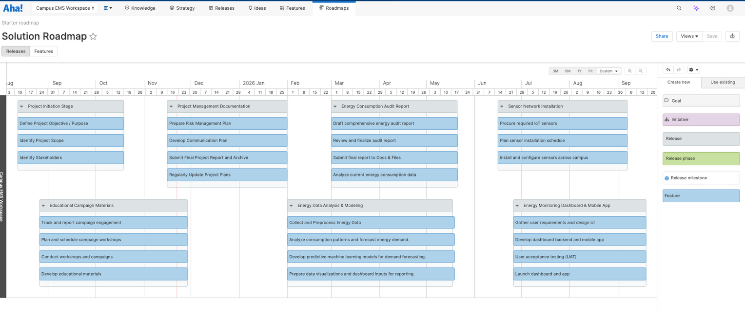
St. Clair College
Solution Roadmap
Aha! Roadmap: https://kcp-technologies.aha.io/bookmarks/roadmaps/7574113798618798674/7575648461849214960
Using Aha! to Organize the Project
  Entered all project tasks and grouped them into key stages: planning, auditing, data analysis, and dashboard development.
  Added timelines for each stage to visualize the workflow from start to finish.
  Aha! automatically generated a clear project roadmap, making it easy to track progress and present the overall plan.
8

Slide 9

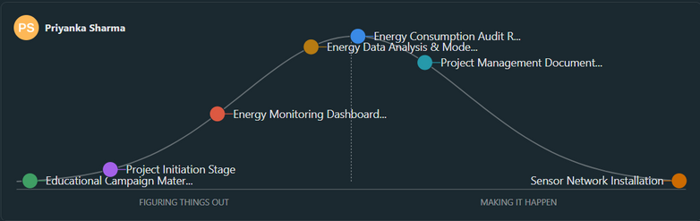
St. Clair College
Project Plan-Using Basecamp
01
Basecamp:
https://3.basecamp.com/6076110/projects/44813742
02
To-Do Lists
7 workstreams covering Project Initiation, Sensor Installation, Dashboard Development, Data Analysis, Audit Report, Campaign Materials, and Documentation
03
Schedule & Milestones
04
  Kickoff: Sept 23, 2025 | Sensor Installation: Oct 15-Nov 15 | Dashboard: Oct 1-Nov 30 | Deadline: Dec 1, 2025
  Ontario Holidays: Christmas (Dec 25), Boxing Day (Dec 26)
Docs & Files
Status: On Track ✅
Project Charter, technical specs, meeting notes, GitHub repository link
Hill Chart Progress
  Planning: Project Initiation, Campaign Materials
  Transition: Dashboard, Documentation
  Execution: Sensor Installation, Data Analysis, Audit Report
Critical Path
Sensor Network Installation
Energy Data Integration
Dashboard Development
Hill Chart
9

Slide 10

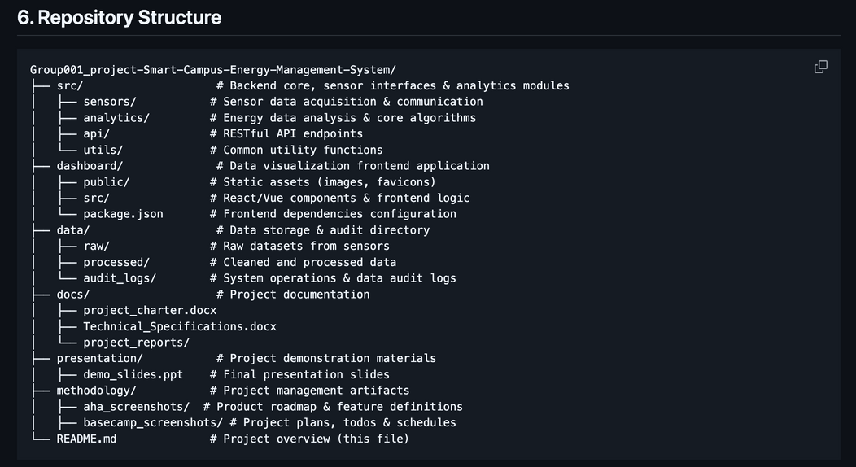
St. Clair College
Implementation
Project Purpose
01
A campus-wide Smart Energy Management System integrating IoT sensors, cloud analytics, and automated building controls to reduce energy consumption and improve operational efficiency.
Core Features
02
  Real-time energy monitoring
  Predictive modeling for demand optimization
  Automated HVAC and lighting control
  Alerts for abnormal consumption
  Campus-wide usage visualizations
System Architecture
03
  Sensing Layer: Smart meters, motion/temperature sensors
  Data Layer: GCP (Compute Engine, Storage, BigQuery)
  Analytics: Energy forecasting, anomaly detection
  Control: Siemens Desigo CC via BACnet
  Interface: Dashboard for facility managers
Repository Structure
10
Github:
https://github.com/GangtieAda/Group001_project-Smart-Campus-Energy-Management-System

Slide 11









St. Clair College
Project planning documents
Energy consumption analysis
  Project charter
  Technical Specifications
  Project reports
  Cleaned and processed energy datasets
  Energy audit report
  Forecasting models and data insights
sensor network setup
  Installed and configured iot energy sensors
  Installation and calibration report
Educational & engagement materials
  Workshop materials and presentation slides
  Campaign schedules
  Engagement tracking reports
Conclusion & Deleverables
Final technology outputs
  Real-time energy monitoring dashboard
  Mobile application for students and staff
  Visual data reports and usage charts
  Final project report and documentation archive
This project offers a practical system for smarter campus energy management. Through data analysis, IoT sensors, and a real-time dashboard, it helps monitor and reduce energy use while supporting long-term sustainability.
11

Slide 12


St. Clair College
Summary of GPT Usage in the Project
Through the Smart Campus Energy Management System project, ChatGPT was used as a support tool to enhance clarity, improve presentation quality, and assist with technical explanations. Specifically, it helped with:
  Content Refinement: Transforming raw text into a more professional, concise, and suitable expression for PowerPoint presentations or reports.
  Technical Explanation: Explaining the technologies involved in the project (e.g., model architecture, data processing workflows).
  Summarization & Rewriting: Summarizing, rewriting, and condensing long paragraphs for use in project descriptions, methodologies, and conclusions.
  Presentation Support: Assisting in optimizing project structure descriptions, visual process narratives, and roadmap descriptions to better suit presentation needs.
  Clarity & Consistency: Ensuring logical coherence and consistent language in documents, enhancing overall professionalism.
12

Slide 13
St. Clair College
Thank you!
Group - 001
Kayode Babalola
Qianru Deng
Priyanka Sharma
13

